Slide 1

ABB IRB 2400
INTRODUCTION TO ROBOTICS
AIE 201

Slide 2
TEAM 1 GROUP MEMBER_NAME
DEEPTHI SUDHARSAN ----------------------------------------------- 19022
ISHA INDHU --------------------------------------------------------- 19030
JAYASHREE O -------------------------------------------------------- 19031
KAVYA S KUMAR ---------------------------------------------------- 19037
LAKSHAYA KARTHIKEYAN -------------------------------------------- 19039
MEGHNA BRIJESH MENON -------------------------------------------- 19043

Slide 3

INTRODUCTION
DH PARAMETERS
FORWARD KINEMATICS
INVERSE KINEMATICS
CODE DEMONSTRATION
APPLICATION
TABLE OF CONTENTS

Slide 4

ABB-IRB 2400
INDUSTRIAL ROBOT

Slide 5
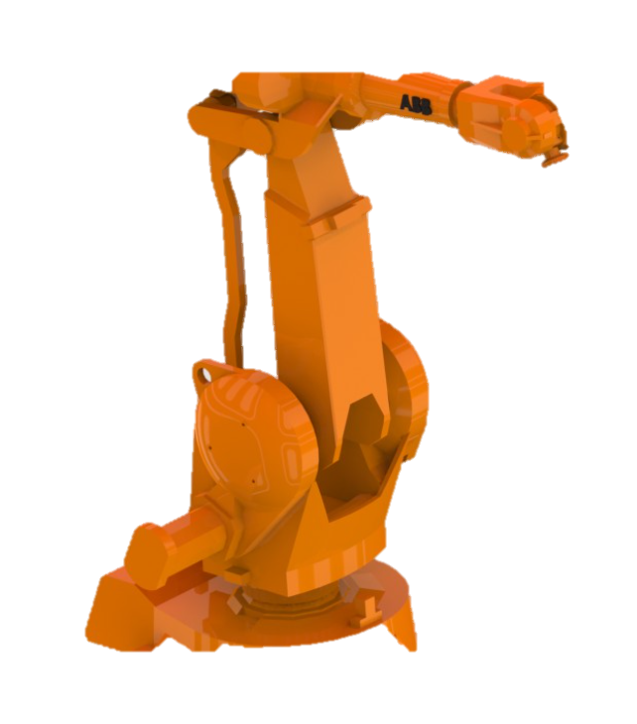
DESCRIPTION
The ABB IRB 2400 is a medium-sized serial robot with a parallel rod.
DEGREE OF FREEDOM | 6
NUMBER OF AXIS | 6
NUMBER OF JOINTS | 6
PAY LOAD | UP TO 20 KG
DUTY CYCLE | 100%
SPECIAL FEATURES | WIDE RANGE, LARGE LOAD OFFSET AND UNLIMITED MOTION IN AXIS 6

Slide 6
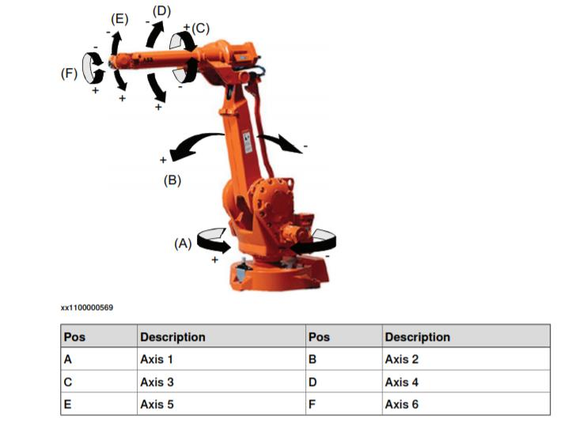
TYPES OF MOTION
IRB 2400 : 6 R Manipulator (R – revolute)
AXIS | TYPE OF MOTION | RANGE OF MOVEMENT
1 | Rotation Motion | -180 to 180
2 | Arm Motion | -105 to 105
3 | Arm Motion | -62.5 to 62.5
4 | Rotation Motion | -200 to 200
5 | Bend motion | -120 to 120
6 | Turn Motion | -400 to 400

Slide 7
DENAVIT–HARTENBERG PARAMETERS
Go!

Slide 8

$$d :offset along previous z to the common normal$$
The Denavit–Hartenberg parameters (DH parameters) are the four parameters associated with a particular convention for attaching reference frames to the links of a spatial kinematic chain, or robot manipulator.
$$θ :angle about previous z_{i} from old x to new x.$$
$$r/a :length of the common normal$$
$$α :angle about common normal, from old z axis to new z axis.$$

Slide 9

The constraints on the relationship between the axes are :
$the x_{n}−axis is perpendicular to both the z_{n−1} and z_{n} axes.$
$the x_{n}−axis intersects both z_{n−1} and z_{n} axes.$
$the origin of joint n is at the intersection of x_{n} and z_{n}.$
$y_{n} completes a right−handed reference frame based on x_{n} and z_{n}.$

Slide 10
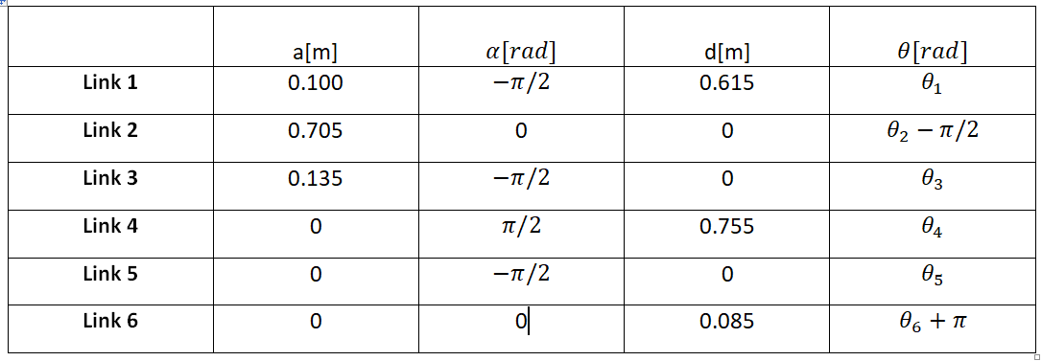
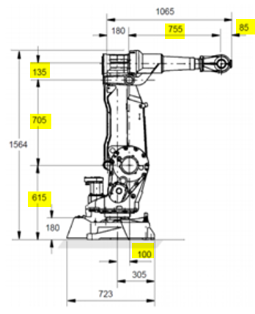
DH Parameters for the IRB-2400 Manipulator

Slide 11
FORWARD KINEMATICS
Go!

Slide 12
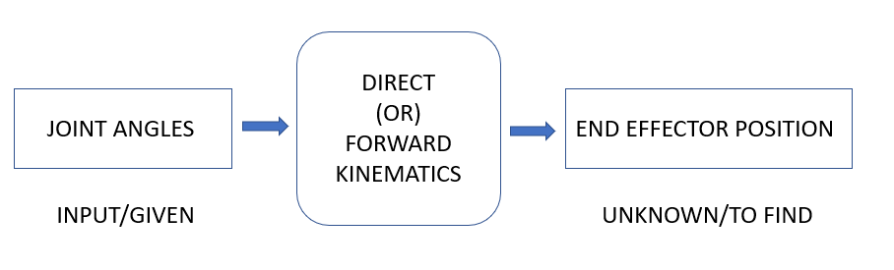
Theory
Forward Kinematics: Finds the position and orientation of the end effector given the joint angles
Transformation matrix: Calculates the relation between the joint variables and the cartesian position coordinates and orientation
Notes:
Forward Kinematics or Direct Kinematics in robotics is the use of kinematic equations to find the position and orientation of the end effector of a robot given the joint angles using a transformation matrix that helps calculate the relationship between the joint variables/parameters and the cartesian position coordinates and orientation of the given robot’s end effector.

Slide 13
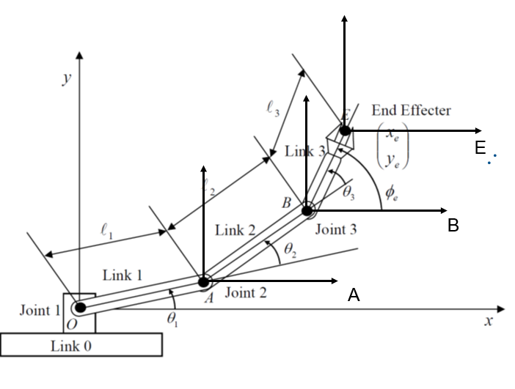
Let’s take an example of a planar manipulator

Slide 14
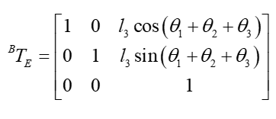
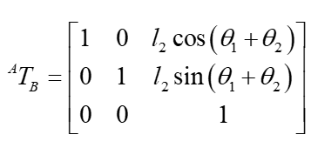
Suppose, we are given the above 2D robotic arm and its joint angles, the first step is to frame the transformation matrix for each link.
STEP 1: We frame the transformation matrices for links OA, AB and BE:

Slide 15
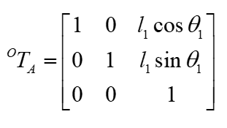
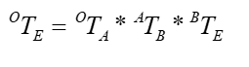
STEP 2: The transformation matrix for the entire robotic arm from O to the end effector E is given by (Complete Homogenous Transformation Matrix that maps from E to O),
STEP 3: We find the coordinates of the end effector by multiplying the body coordinates of the end effector with the compound transformation matrix and equating it with the global position coordinates of the end effector.

Slide 16
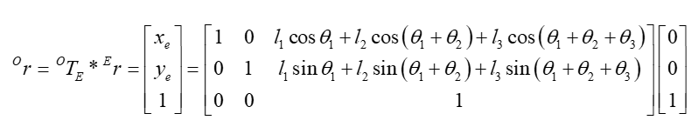
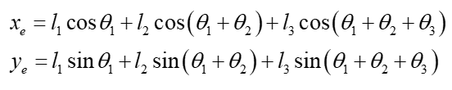
Or - Position of end effector E from O Coordinate system
Er – Position of end effector from E Coordinate system

Slide 17
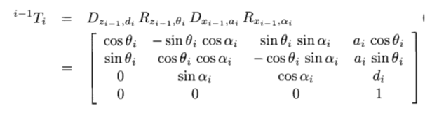
General Formula for Transformation matrix using DH parameters
Transformation matrix mapping i to i-1 is given by,

Slide 18
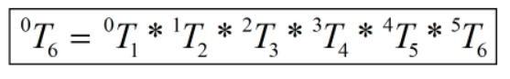
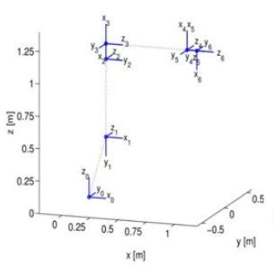
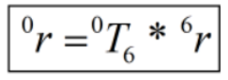
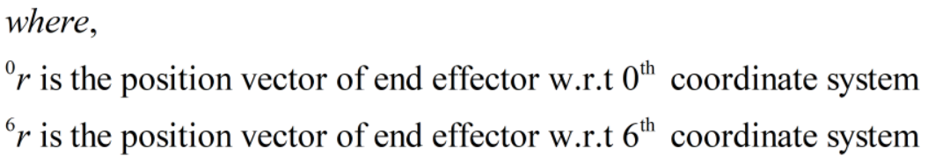
The complete Transformation matrix for IRB 2400 is given by
The position of the end effector’s coordinates w.r.t the base frame:

Slide 19
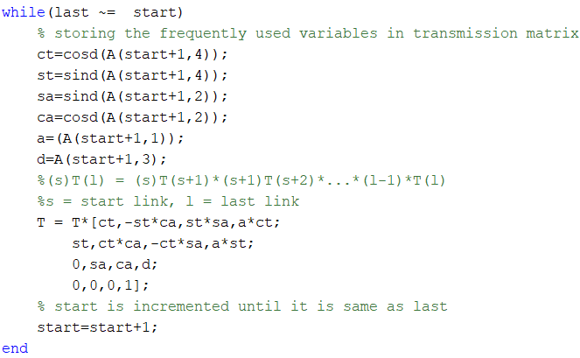
TRANS_MATRIX

Slide 20
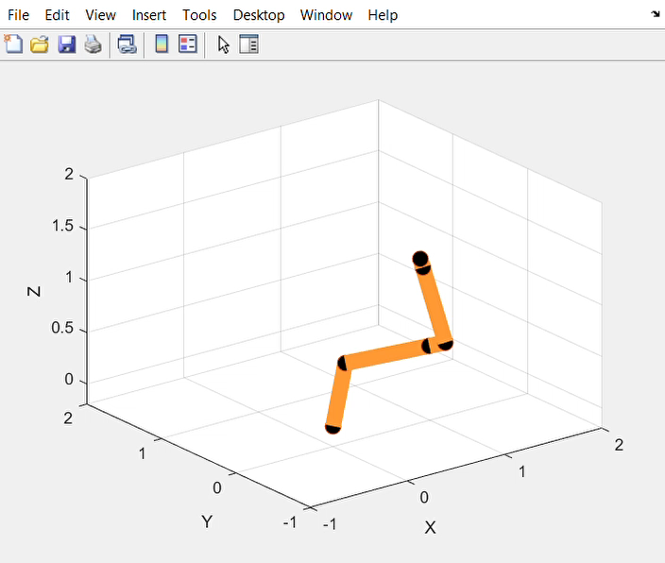
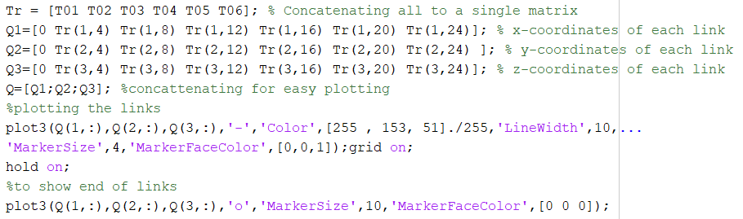
SIMULATION

Slide 21
INVERSE KINEMATICS
Go!

Slide 22
Theory
Process of determining the joint variables in terms of the end-effector position and orientation
Mathematically: searches for the elements of vector Q when a transformation is given as a function of the joint variables (qn)
Robotic links → actuated in the joint variable space
Objects to be manipulated → expressed in the global coordinate frame
Carrying kinematic information between the two spaces is needed
To control the configuration of the end-effector to reach an object, the inverse kinematics solution must be solved
Notes:
Computer controlled robots are usually actuated in the joint variable space, however objects to be manipulated are usually expressed in the global coordinate frame. Therefore, carrying kinematic information , back and forth, between joint space and Cartesian space, is a need in robot applications. To control the configuration of the end-effector to reach an object , the inverse kinematics solution must be solved. Hence, we need to know what the required values of joint variables are, to reach a desired point in a desired orientation.

Slide 23
DECOUPLING:
Inverse Position
Inverse Orientation
Inverse Kinematics
Notes:
It is possible to decouple the inverse kinematics problem into two subproblems, known as inverse position and inverse orientation kinematics. The practical consequence of such a decoupling is the allowance to break the problem into two independent problems, each with only three unknown parameters. Following the decoupling principle, the overall transformation matrix of a robot can be decomposed to a translation and a rotation

Slide 24
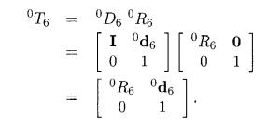
decoupling :
The transformation matrix can be decoupled as a translation (D) and a rotation matrix (R)
Translation matrix D6: solved for wrist position variables
Rotation matrix R6: solved for wrist orientation variables
Notes:
It is possible to decouple the inverse kinematics problem into two subproblems, known as inverse position and inverse orientation kinematics. The practical consequence of such a decoupling is the allowance to break the problem into two independent problems, each with only three unknown parameters. Following the decoupling principle, the overall transformation matrix of a robot can be decomposed to a translation and a rotation

Slide 25
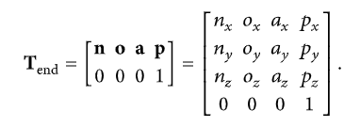
Solving for the JOINT VARIABLES:
Input transformation matrix:
n, o, a → unit orientation vectors
p → position vector of the end effector w.r.t to the global frame

Slide 26
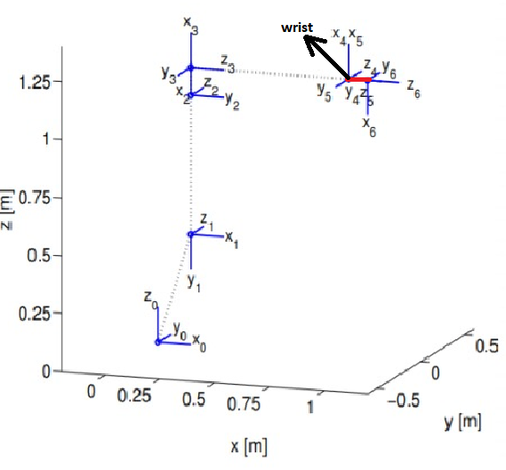

Joint angle 1:
End effector coordinates are brought to the wrist position
The end effector coordinates (P) must be moved a certain distance (L6) along the z component (W) of its coordinate system to obtain the wrist coordinates (Pm)
These coordinates are in turn used to find the first joint angle
$$θ_{1}=\tan^{−1}{\frac{Pmy}{Pmx}}$$
Notes:
This allows us to easily solve the first three joint variables

Slide 27
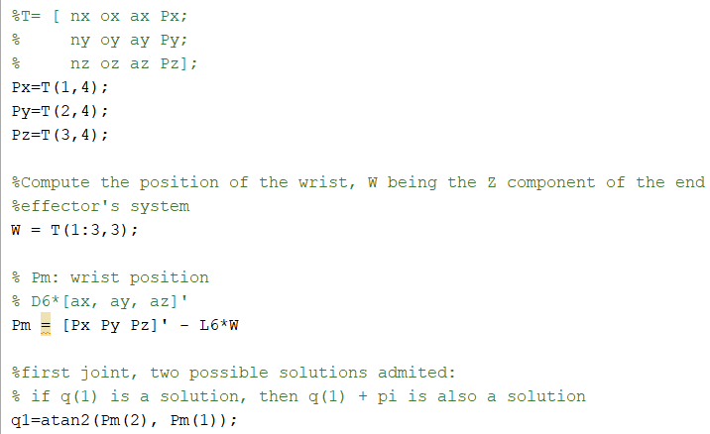
CODE to solve Q1 :

Slide 28
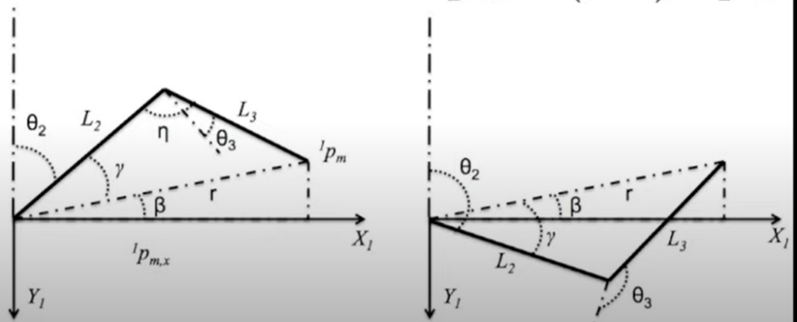
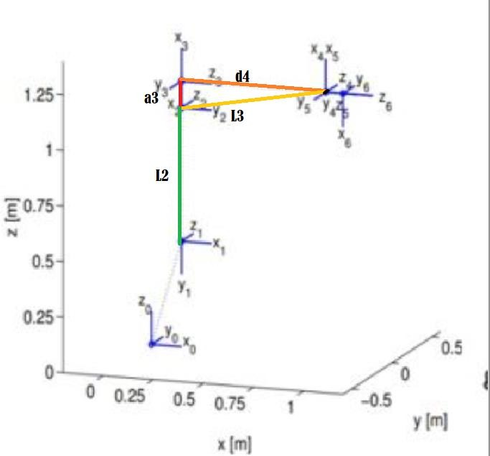
Joint angle 2: notations
1Pm: wrist coordinates w.r.t the 1st frame
L₂ (a2): length of link 2
L₃ : length of the line joining the origin of frame 2 and the wrist coordinates → sqrt(a3^2 + d4^2)
r is the length of the line joining origin of frame 1 and the wrist coordinates

Slide 29



Joint angle 2: calculation
The 1st DH transformation matrix is computed to get 1Pm
β = $\tan^{−1}\left(\frac{{1P}_{my}}{{1P}_{mx}}\right)$
ϒ = $\cos^{−1}\left(\frac{L_{2}^{2} + r^{2}−L_{3}^{2}}{2rL_{2}}\right)$
1P_{m} = ${{}_{1}^{0}T}^{−1}∗P_{m}$
r = $\sqrt{{{1P}_{mx}}^{2}+{{1P}_{my}}^{2}}$
$θ_{2}=\frac{π}{2} − β – ϒ$ (elbow up)
$θ_{2}=\frac{π}{2} − β + ϒ$ (elbow down)

Slide 30
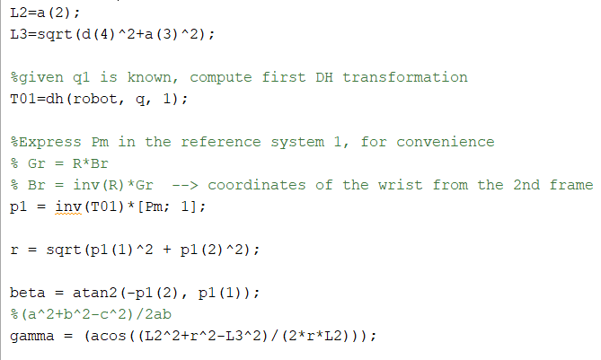
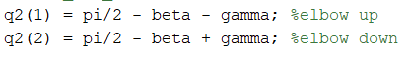
Code to solve q2:

Slide 31
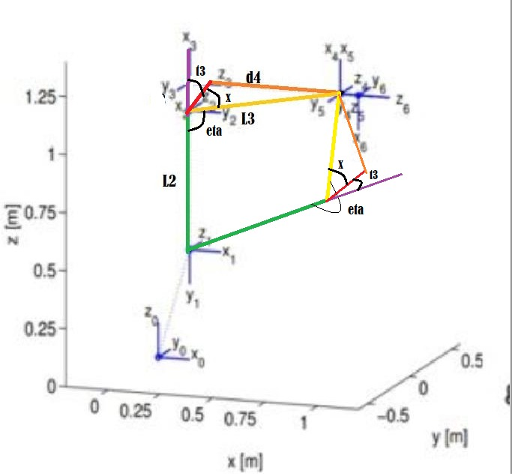


Joint angle 3:
From the figure:
$$η=\cos^{−1}\left(\frac{L_{2}^{2}+L_{3}^{2}−r^{2}}{2L_{2}L_{3}}\right)$$
$$x=\tan^{−1}\left(\frac{d_{4}}{a_{3}}\right)$$
Elbow up:
$$π=η−x−θ_{3}$$
$θ_{3}=η−x−$ $π$
Elbow down:
$$π=θ_{3}+x+η$$
$$θ_{3} =π−x−η$$
Notes:
This allows us to easily solve the first three joint variables

Slide 32
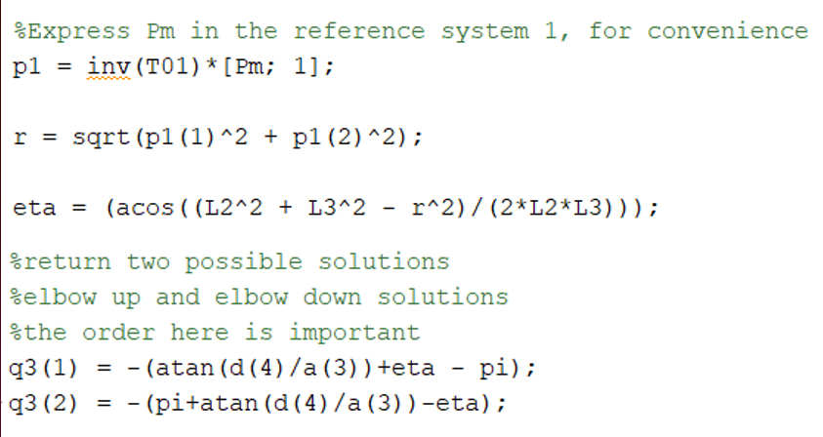
Code to solve q3:

Slide 33



Joint angles 4, 5 & 6:
$$R_{6}^{3}=\left[\begin{matrix}sinθ_{4}sinθ_{6}−cosθ_{4}cosθ_{5}cosθ_{6} & cosθ_{6}sinθ_{4}+cosθ_{4}cosθ_{5}sinθ_{6} & −cosθ_{4}sinθ_{5} \\ −cosθ_{4}sinθ_{6}−sinθ_{4}cosθ_{5}cosθ_{6} & cosθ_{5}sinθ_{4}sinθ_{6}−cosθ_{4}cosθ_{6} & −sinθ_{4}sinθ_{5} \\ −cosθ_{6}sinθ_{5} & sinθ_{5}sinθ_{6} & cosθ_{5}\end{matrix}\right]$$
$$R_{6}^{3} =\left[\begin{matrix}s_{11} & s_{12} & s_{13} \\ s_{21} & s_{22} & s_{23} \\ s_{31} & s_{32} & s_{33}\end{matrix}\right]$$
$$R_{6}^{3}={\left(R_{3}^{0}\right)}^{−1}R_{6}^{0}$$
$θ_{4}$ = $\tan^{−1}\left(\frac{s_{23}}{s_{13}}\right)$
$θ_{5}$ = $\cos^{−1}\left(s_{33}\right)$
$θ_{6}$ = $\tan^{−1}\left(\frac{s_{32}}{{−s}_{31}}\right)$

Slide 34
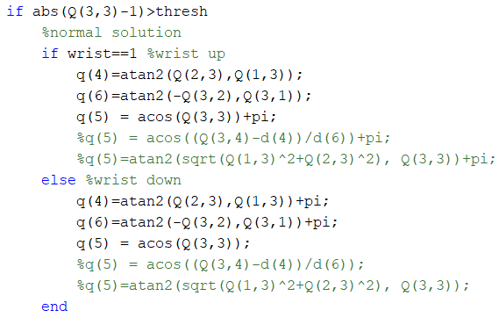
Code to solve q4,q5,q6:

Slide 35
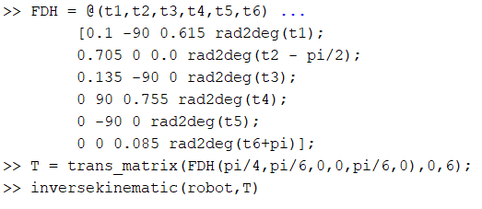
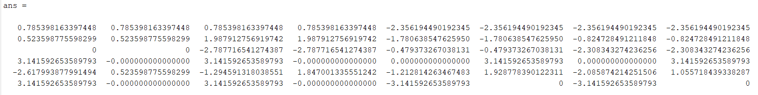
OUTput:

Slide 36
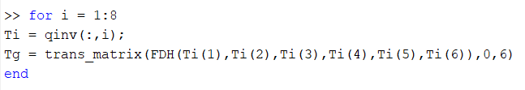
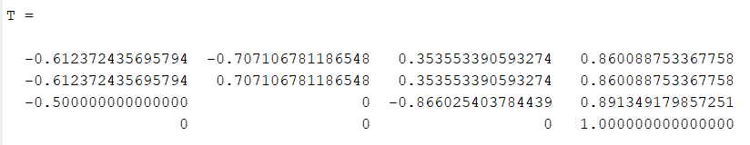
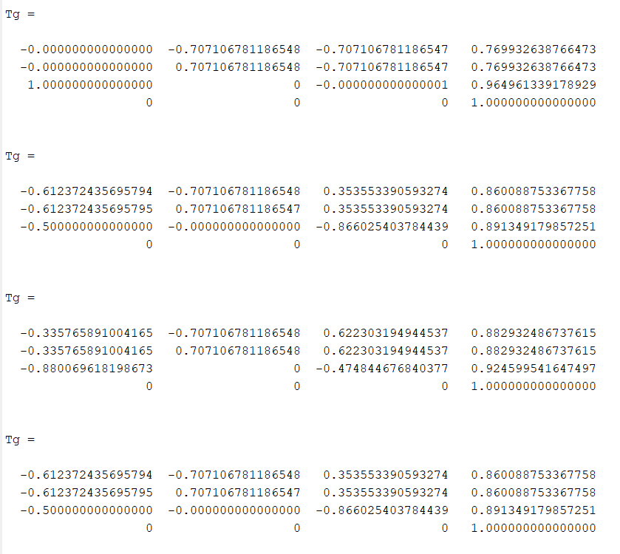
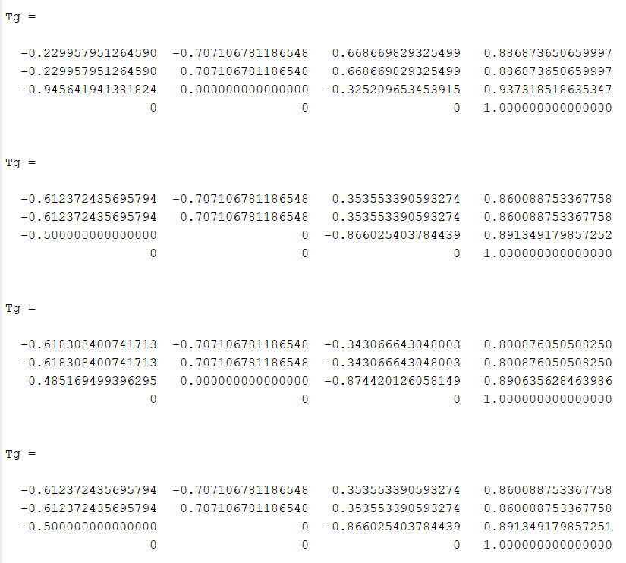

Slide 37
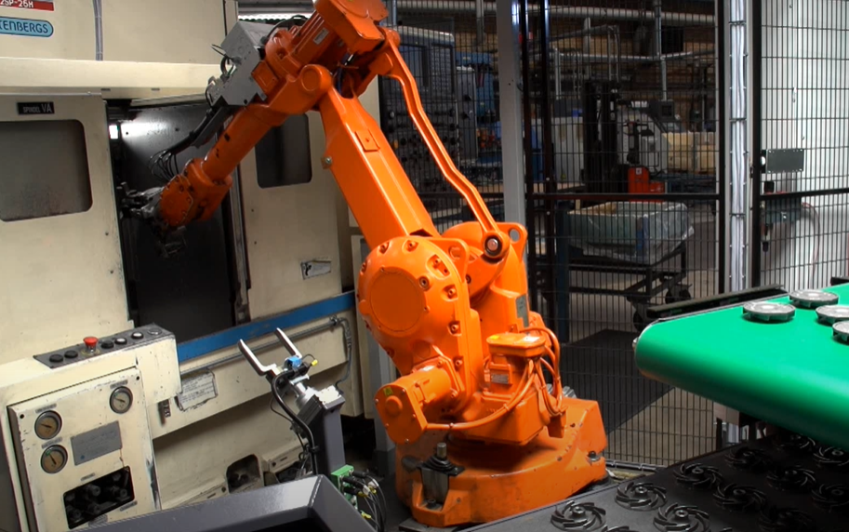
Advantages :
Flexibility
Wide range of workspace
Reduce man power
High quality and precision
Safety measurements

Slide 38

CUTTING
GRINDING
POLISHING
ARC WELDING
APPLICATION
S
DEBURRING

